Slide 1

Fitness Treat
GLA University
Mathura-281406 , India

Slide 2
Under THE
SUPERVISION OF:
MR. Pankaj Kapoor
PRESENTED BY:​
KRISHNA GUPTA (181500330)
MUKUL AGRAWAL (​181500397)
MUKUND AGRAWAL (181500401)​

Slide 3
Agenda
Introduction
Problem Statement
Objective
Languages Used
Screenshots of project
Conclusion

Slide 4
Introduction
Title of Project : Fitness-Treat
The Problem Statement :
It is with no doubt that regular exercise and physical activity contribute to body fitness and psychological health. Some of the well-known benefits of exercise are controls weight, combats health diseases, improves emotional stability, promotes better sleep.

Slide 5
Objective
Fitness Treat is a fitness related website.
It’s goal is to provide proper diet and exercise plan to make the peoples healthier and increase their chances to living longer.
To promote healthy life style and reduce health risk.

Slide 6
Languages Used
HTML :
It is used to describe the structure of web page.
CSS :
It is used to style , formatting of web page.
Javascript :
It is used to create interactive web pages by providing the functionality to them.
Bootstrap :
It is a free and open-source CSS framework to make responsive web pages.

Slide 7
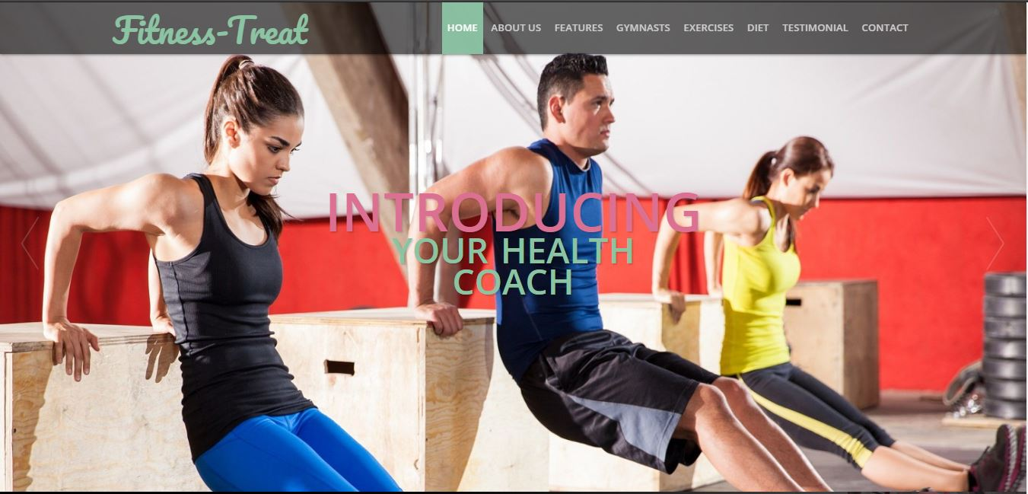
Screenshots of Project

Slide 8
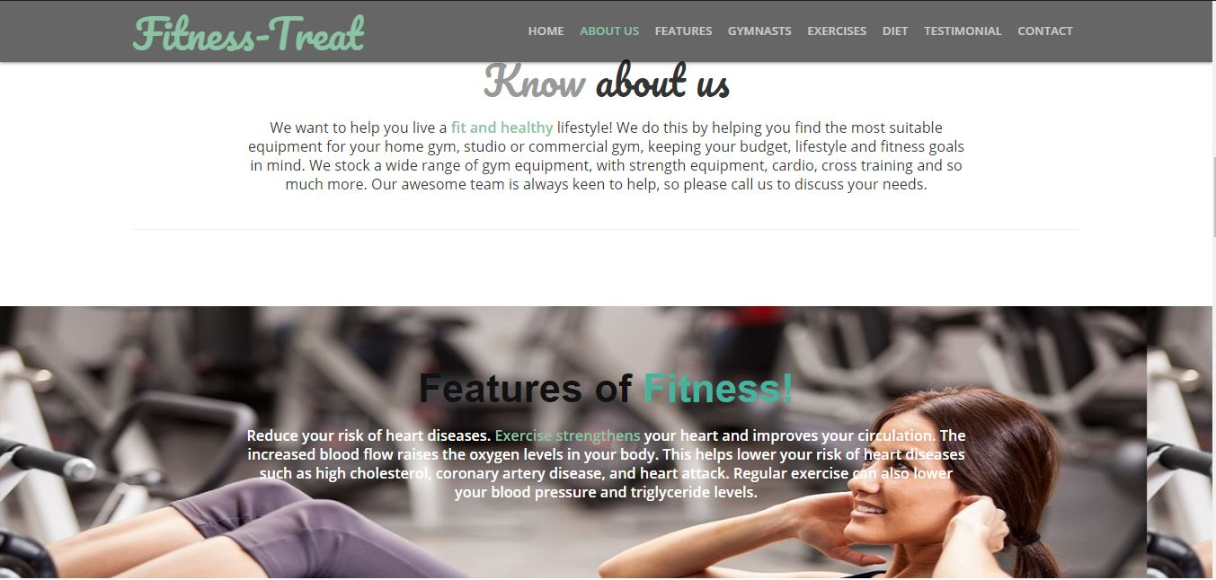

Slide 9
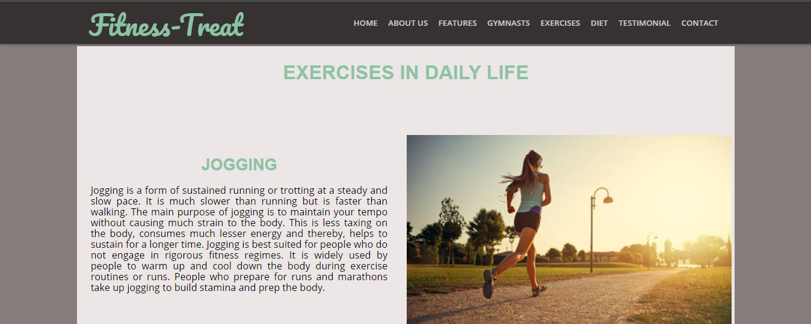

Slide 10
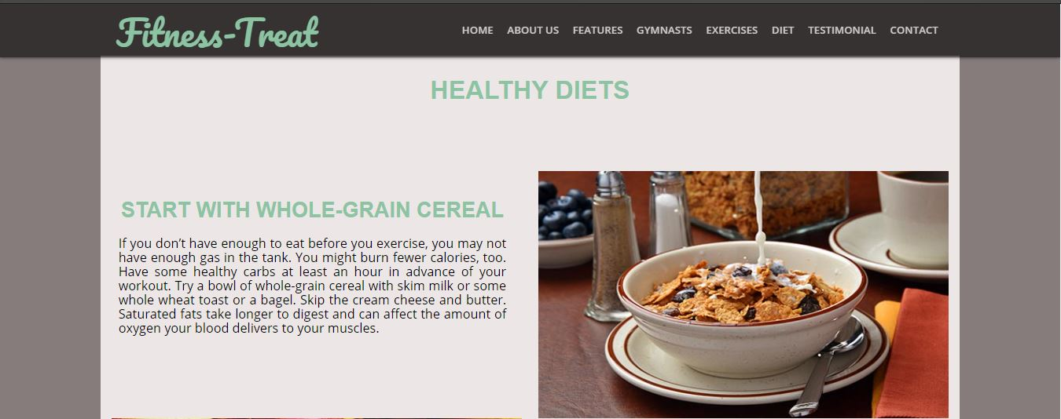

Slide 11
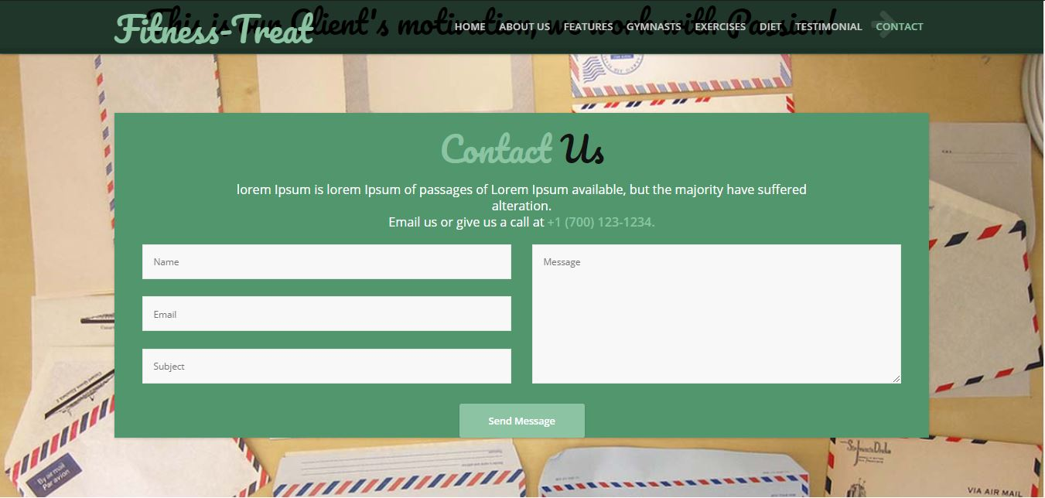

Slide 12
Conclusion
Exercises will help the people in form of energy booster and they will keep their body healthy using proper diets.
This will help for the following:
Weight Management : Both diet and physical activity play a critical role in maintaining a healthy body weight, losing excess body weight.
2) Strengthen Your Bones and Muscles : As you age, it’s important to protect your bones, joints, and muscles – they support your body and help you move. Keeping bones, joints, and muscles healthy can help ensure that you’re able to do your daily activities and be physically active.

Slide 13
Thank You

